Slide 1

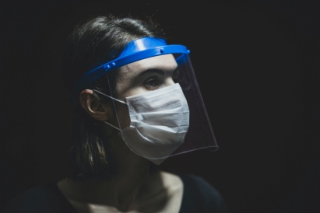
FACE MASK
DETECTION!
Notes:
To use this title animation slide with a new image simply 1) move the top semi-transparent shape to the side, 2) delete placeholder image, 3) click on the picture icon to add a new picture, 4) Move semi-transparent shape back to original position, 5) Update text on slide.

Slide 2
INTRODUCTION
Motivation
Living through a pandemic is strange. Most of us have never been asked to make sacrifices like this before -- staying home and limiting contact with others.
All that disruption can make people anxious. And for some, that includes ignoring the novel corona virus altogether and carrying on as though it's business as usual.
Despite repeated pleas from public health and government officials to stay at home and slow the spread of Covid-19, many people just won't.
Although there are few basic requirements for which people are helpless and they have to get out from their homes.
With so many people infected worldwide, the Covid-19 pandemic shows no signs of abating. As permanent solution is yet to be found, lockdowns remain the only way to slow its spread. However, the lockdowns are also pushing major economies to the brink.
Solution
Many things can’t be stopped like the patients who have to go through medical procedures once in a week or people from small towns need to buy food themselves due to lack of online services.
What we can do is just follow certain precautions and guidelines which can help us to survive this pandemic.

Slide 3
OBJECTIVE
To build an application which identifies a user that he/she was not wearing a mask, an alert goes out and enforces the wearing of the mask.
“Airports”
The Face Mask Detection System can be used at airports to detect travelers without masks. Face data of travelers can be captured in the system at the entrance. If a traveler is found to be without a face mask, their picture is sent to the airport authorities so that they could take quick action.
“Hospitals ”
Using Face Mask Detection System, Hospitals can monitor if their staff is wearing masks during their shift or not. If quarantine people who are required to wear a mask, the system can keep an eye and detect if the mask is present or anyone who enters the hospital should be wearing a mask.
“Offices/Supermarkets”
The Face Mask Detection System can be used at office premises to detect if employees are maintaining safety standards at work. While entering any general stores or super market, there can be a camera scan at the entrance and only those customers wearing masks will be allowed to enter.

Slide 4
Visual Studio code
REQUIREMENTS
(Software and hardware)
!
Jupyter Notebook
A well functioning computer for the model to be deployed.
Secondary memory to store all the images and database.
Camera to detect people

Slide 5
THE Following Steps were Followed to
BUILD the Model
1
2
3
4
5
Data
Acquisition
Data
Preparation
Data
Balancing
Data
Splitting
Training and Testing Model*
*Training and testing includes analyzing, labeling, classifying, detecting images, correcting errors etc.

Slide 6
1.
2.
LOCAL BINARY PATTERNS HISTOGRAM
START
START
INPUT FACE IMAGE
LOAD CAMERA
DIVIDE FACE IMAGE INTO BLOCKS
IF CAMERA OPENS ?
(LBPH)
In this method we characterize each image in dataset locally, and when a new unknown image is provided, we perform some analysis on it and compare the result to each of the images in the dataset. The way which we analyse the images is by characterizing the local patterns in each location in the image.
CALCULATE HISTOGRAM FOR EACH BLOCK
Combine LBPH histogram into single histogram
DETECT FACE
FACE IMAGE PROCESSED
Perform Image Pre-processing
EXTRACT FEATURES
DETECT AND RECOGNIZE IMAGE
RECOGNIZE FACE
*Figure 1 and 2 represents flow chart of face mask detection of saved datasets and live data respectively based on LBPH.
END
END

Slide 7
PHASE #1 : TRAIN FACE MASK DETECTOR
ACTIVITY DIAGRAM
LOAD FACE MASK DATASET
Train Face Mask Classifiers with LBPH
SERIALIZE FACE MASK DETECTION TO DISK
Phases and individual steps for building a COVID-19 face mask detector using Python and OpenCV.
PHASE #2 : APPLY FACE MASK DETECTOR
The Activity Diagram explains how the model works. It specifies how the dataset is trained and model shows results.
LOAD FACE MASK CLASSIFIER FROM DISK
DETECT FACES IN IMAGE/VIDEO STREAM
EXTRACT EACH FACE Region Of index (ROI)
SHOW RESULTS
ALERT MODEL IF NO MASK!!
APPLY LABEL TO DETERMINE “MASK” OR
“NO MASK”
Whenever a face with No Mask is detected, the model alerts to wear masks and keeps on warning until mask is applied.

Slide 8
USER MODEL:
USE CASE DIAGRAM
USER
ADD IMGAE/OPEN CAMERA
A use case diagram at its simplest is a representation of a user's interaction with the system that shows the relationship between the user and the different use cases in which the user is involved.
DETECT FACE
DETECT FACE MASK
ALERT! IF NO MASK
A UML use case diagram is the primary form of system/software requirements for a new software program underdeveloped.
SOFTWARE MODEL:
RECEIVE IMAGE
DETECT FACE
The purpose of use case diagram is to capture the dynamic aspect of a system.
FACE
DETECTOR
DETECT FACE MASK
SHOW RESULTS

Slide 9
DATA FLOW DIAGRAM
Add image/open camera
Receive image
DETECTING
RECOGNIZING
USER
FACE MASK DETECTOR
Check results
Detect face mask
A Data-flow diagram is a way of representing a flow of data of a process or a system.

Slide 10
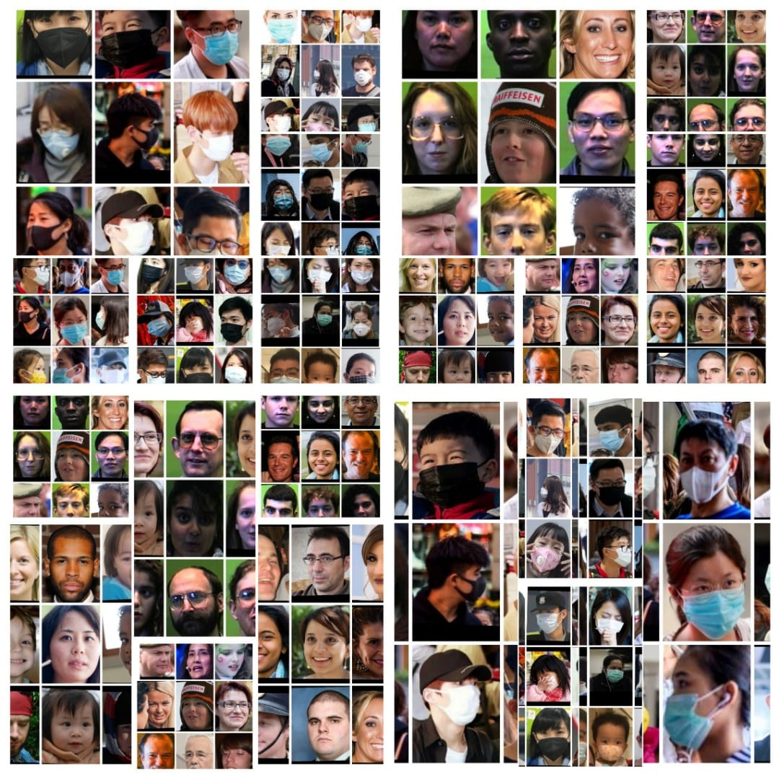
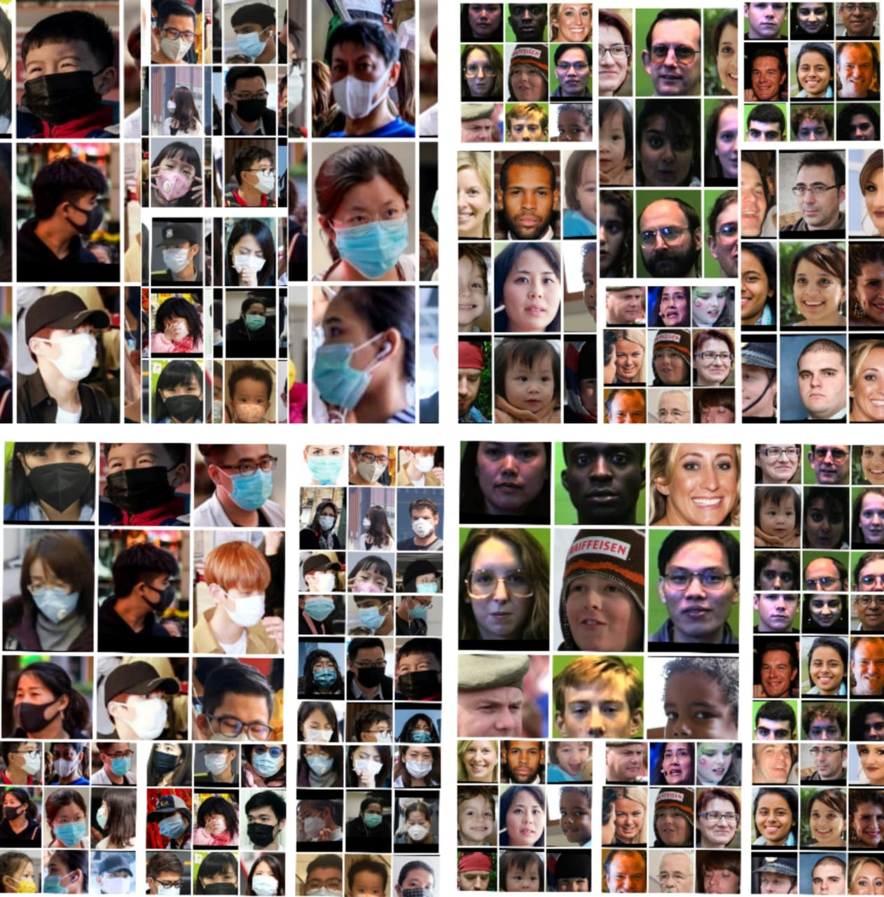
THE MASK AND NO MASK DATASET
*Overall data is around 4k+
Notes:
Tip:
When using complex image as full-bleed background add a transparency (70%-90%) fill layer to give contrast to text.

Slide 11
Test cases :
Serial Number | Action | Input | Expected output | Actual output | Test Result
1 | Detect face | A person’s face | Face is detected | A rectangular window detects face | passed
2 | Detect mask or no mask | A person’s face | Whether face is covered with mask or not | Results are shown whether there is a ask or not | passed
3 | Alert if there is no mask | A person’s face without mask | Machine alerts the person | person is asked to wear mask | passed
4 | Detect 4 faces | 4 people facing camera | Faces are detected | Rectangular boxes detects all 4 faces | passed
5 | Detect more than 4 faces | Multiple faces | Faces are detected | All faces are not detected | failed

Slide 12
Conclusion
The use of face mask detection system has become an easier and cheaper technology with advances in technology of Machine Learning and Artificial Intelligence.
In this project, a new method to detect whether a person is wearing a face mask or not is proposed. This method uses the Local Binary Patterns Histogram (LBPH) classifier.
The obtained results demonstrate the effectiveness of the proposed method to detect face mask.
The other advantage of this method is its simplicity. In particular, gray image acquired with a low cost webcam can be used as inputs to the system. This allows the application to run on all systems that use a webcam for acquisition.
In perspective, it is envisaged to realize a recognition system, which can detect the persons wearing a mask or not and alert them, without the necessity of a verification step.

Slide 13
Future
Scope
Today, one of the fields that uses face detection the most is security. Face detection is a very effective tool that can help law enforcers recognize criminals and software companies are leveraging the technology to help users access their technology. This technology can be further developed to be used in other avenues such as ATMs, accessing confidential files, or other sensitive materials. This can make other security measures such as passwords and keys obsolete.
Another way that innovators are looking to implement facial recognition is within subways and other transportation outlets. They are looking to leverage this technology to use faces as credit cards to pay for your transportation fee. Instead of having to go to a booth to buy a ticket for a fare, the face detection would take your face, run it through a system, and charge the account that you’ve previously created. This could potentially streamline the process and optimize the flow of traffic drastically. The future is here.

Slide 14
THANK YOU

